Slide 1
Day 32
Range Sensor Models

Slide 2
Range Sensors
range sensors measure the distance between the robot and the sensed object(s)
  bearing measurement can be obtained by rotating the sensor or using multiple sensors arranged on a circular arc
many non-vision based sensors can be modeled by measuring the distance along a beam or cone

Slide 3
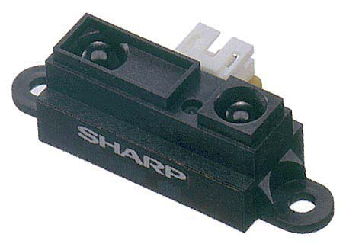
Infra-red Range Sensor
uses an IR LED and a linear CCD array to triangulate distances
object
object
angle increases as distance increases
Sharp GP2Y0A21YK0F data sheet

Slide 4
Infra-red Range Sensor
has a minimum and maximum distance
  changes depending on the model but range is on the order of a few centimeters to a few meters
inexpensive (less than $20)
measurements affected by the material properties of the object
  but less sensitive to the orientation of the reflecting surface
low accuracy

Slide 5
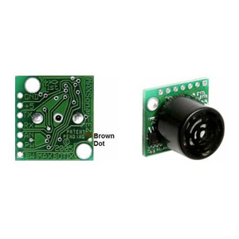
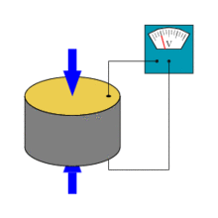
Ultrasound Range Sensors
ultrasound is sound above the upper limit of human hearing (approximately 20,000 Hz)
inexpensive ultrasonic transducers are essentially ceramic discs that vibrate at ultrasonic frequencies
  operate via the piezoelectric effect
    an applied external electric field causes a small change in the physical dimensions
    conversely, an applied stress will induce a small electric field

Slide 6
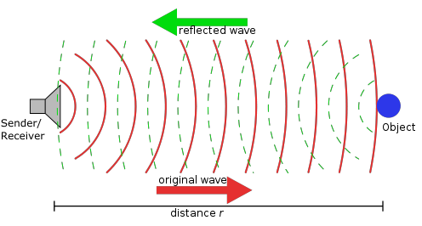
Ultrasound Range Sensors
basic idea of operation is simple
  transducer emits a short pulse of ultrasound
  receiver listens for echo
  time elapsed between pulse and echo is proportional to twice the distance to the object

Slide 7
Ultrasound Range Sensors
speed of sound in air is given approximately by
where T is temperature in Celsius
  humidity affects c
modern electronics can easily measure elapsed time with sufficient precision to obtain good distance resolution

Slide 8
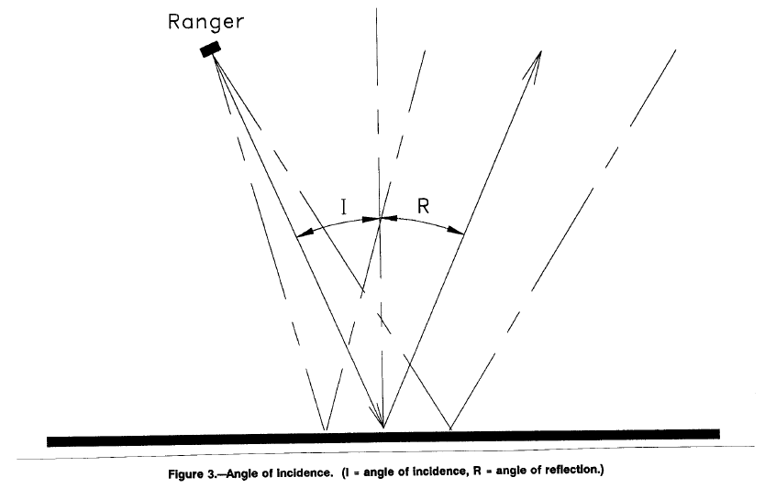
Ultrasound Range Sensors
most materials are specular reflectors of ultrasound

Slide 9
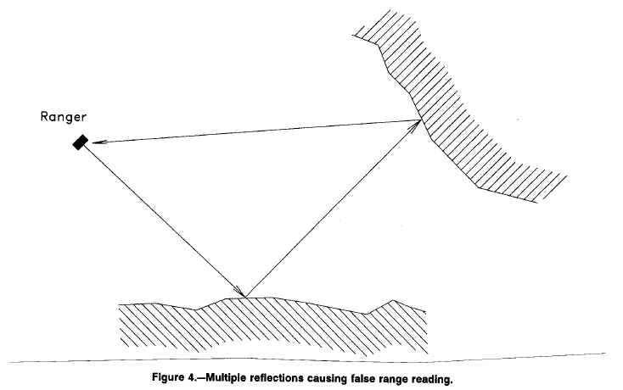
Ultrasound Range Sensors
multiple reflections produce erroneous distance measurements
Strickland and King, “Characteristics of Ultrasonic Ranging Sensors in an Underground Environment”

Slide 10
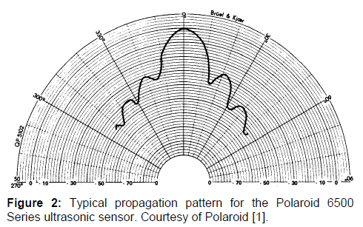
Ultrasound Range Sensors
unfocussed ultrasound transducers have a wide beam pattern with significant side lobes
Cao and Borenstein, “Experimental Characterization of Polaroid Ultrasonic
Sensors in Single and Phased Array Configuration”

Slide 11
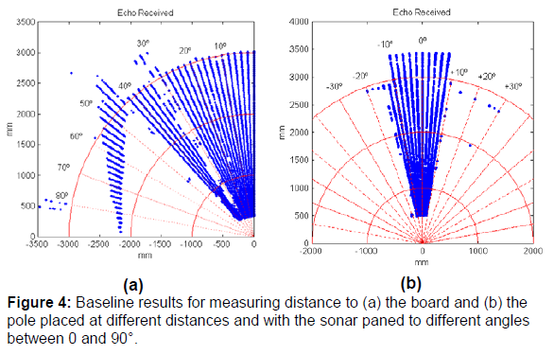
Ultrasound Range Sensors
beamwidth + side lobes leads to spurious measurements
Cao and Borenstein, “Experimental Characterization of Polaroid Ultrasonic
Sensors in Single and Phased Array Configuration”

Slide 12
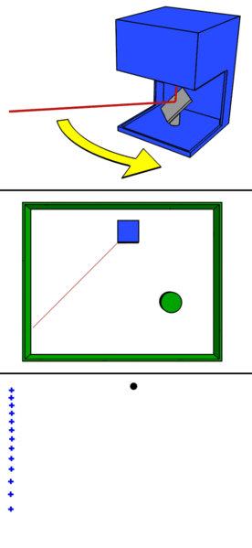
LIDAR
light detection and ranging
commercial range finder
disassembled

Slide 13
LIDAR
for time of flight sensor
  speed of light
  1 ns = 150 mm
  100 ps = 15 mm
  10 ps = 1.5 mm
typical angular resolution below 1 degree
typical errors on the order of 10 cm or less
cost > $1,000

Slide 14
Beam Models of Range Finders
given the map and the robot’s location, find the probability density that the range finder detects an object at a distance
along a beam
the k is here because range sensors
typically return many measurements
at one time; e.g., the sensor might
return a full 360 degree scan made
up of K measurements at once

Slide 15
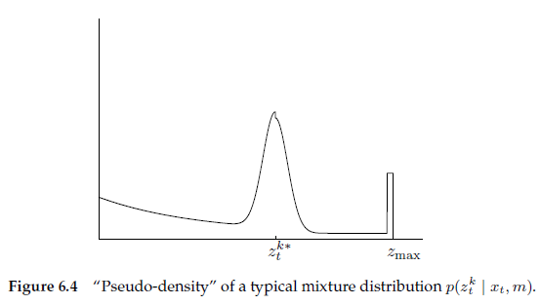
Beam Models of Range Finders
most range finders have a minimum and maximum range
we seek a model that can represent
  the correct range measurement with noise
  unexpected obstacles
  failures
  random measurements
1
3
2

Slide 16
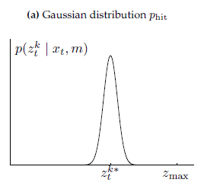
Beam Models of Range Finders
Correct Measurement with Noise
suppose that the beam intersects an obstacle at a range of
  model this measurement as a narrow Gaussian with mean

Slide 17

Beam Models of Range Finders
Unexpected Obstacles
in a dynamic environment there will be obstacles not found on a static map; these obstacles will cause range measurements shorter than expected
if such obstacles appear continuously and independently at a constant average rate then they can be modeled as a Poisson process
the time between events in a Poisson process has an exponential distribution with probability density function

Slide 18
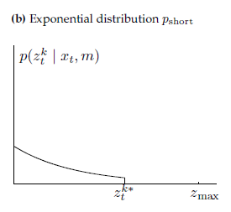
Beam Models of Range Finders

Slide 19
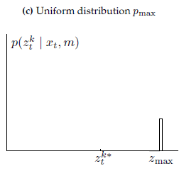
Beam Models of Range Finders
Failures
range finders can fail to sense an obstacle in which case most sensors return
modeled as a point mass distribution centered at

Slide 20
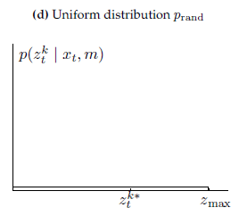
Beam Models of Range Finders
Random Measurements
unexplainable measurements are modeled as a uniform distribution over the range [0, ]

Slide 21
Beam Models of Range Finders
the complete model is a weighted sum of the previous four densities with weights

